Slide 1

RNS Institute of Technology
(AICTE Approved, VTU Affiliated and NAAC ‘A’ Accredited)
Department of Information Science and Engineering
(Accredited by NBA for the Academic Years 2018-19, 2019-20 and 2020-21)
Data structures Laboratory-18CSL38
Staff in Charge: Mrs. Faculty Name
Designation: Assistant Professor
Carried out by:
SATYAM JHA(1RN19IS136)
SHRESTH BIHARI (1RN19IS144)
YASH ANAND(1RN19IS183)

Slide 2
Abstract
Introduction
Objective of the project
Data Structure
System requirements
Project Architecture
Implementation modules
Results
Conclusion & Future Enhancements
References
Department of ISE,RNSIT

Slide 3
Guessing Game is a C++ interactive menu driven program which focus to use and
manipulate functions , loops , vectors , strings and hashing.
Department of ISE,RNSIT

Slide 4
This game has three choices to play :
Guessing number : The player would be given 7 chances
to guess the correct number from 1 to 100 . If the player
predicts the correct number he/she would win else the
computer would provide if the number is greater or less
than the predicted number within 7 chances.
Guessing word : This is a single or double player game . There
are difficulty level and some jumbled words to guess . At the
end the respective scores of the players and the wrong guessed
words are printed .
Department of ISE,RNSIT

Slide 5
Casino Royale : The player enter with some amount of money
and if he/she guesses the correct number from 1 to 10 , the
amount gets doubled else the amount gets deducted with
some conditions .
Department of ISE,RNSIT

Slide 6
Better understanding and enhancing the skills of the C++ language.
Implementation of Data structures.
To have a good knowledge of the C++ built in libraries such as the rand functions etc.
Get Entertained and have fun while coding.
Department of ISE,RNSIT

Slide 7
Data structure used in this project are mapping , vectors and strings .
Mapping is used to display the difficulty level of the words .
We have stored a key value of each difficulty level
corresponding to the vector of strings used in the Guessing Word
game.
It has been initialized (in the code) as :
unordered_map<int , vector<string>>m;
Department of ISE,RNSIT

Slide 8
User requirements :
Operating system such as Windows , Linux etc.
IDE’s (Integrated Development Environment) such as
Dev C++ , sublime text , codeblocks , etc. .
Department of ISE,RNSIT

Slide 9


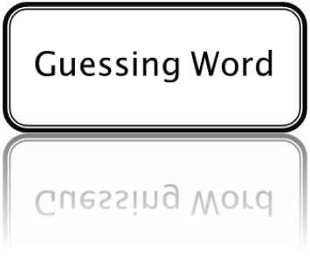
C++ code
Flowchart - 1
Department of ISE,RNSIT

Slide 10




GUESSING NUMBER
7 CHANCES
(No. 1-100)
IF GUESSED THE CORRECT NO.
WIN
IF CHANCES <= 7
Entered number is less or greater than the correct No.
LOSE
Flowchart - 2
Department of ISE,RNSIT

Slide 11
GUESSING WORD
JUMBLED WORDS
DIFFICULTY
LEVEL 1
5 WORDS
LEVEL 2
5 WORDS
END
SCORES & ANSWERS
Flowchart - 3
Department of ISE,RNSIT

Slide 12
EXIT
CASINO ROYALE
DEPOSIT AMOUNT
NO
DEPOSIT AMOUNT
+ 10 BET AMOUNT
BET AMOUNT
YES
CORRECT
GUESS NO. : 1-10
DEPOSIT AMOUNT – BETTING AMOUNT
WRONG
CONDITION TO PLAY MORE OR NOT
Flowchart - 4
Department of ISE,RNSIT

Slide 13
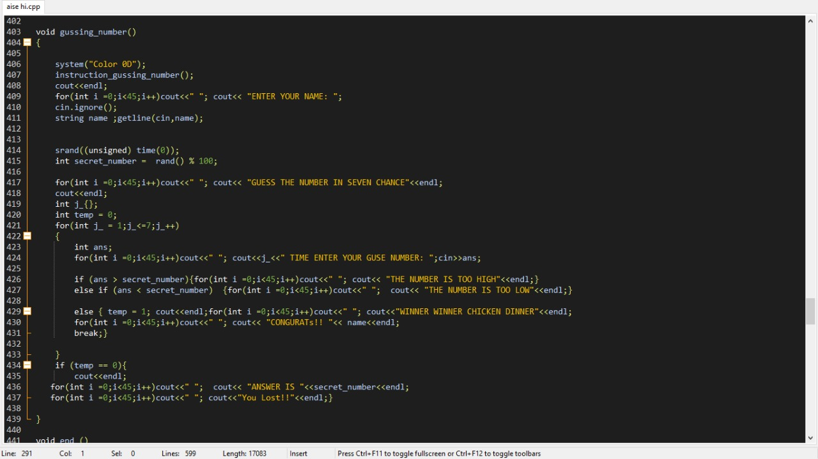
Department of ISE,RNSIT

Slide 14
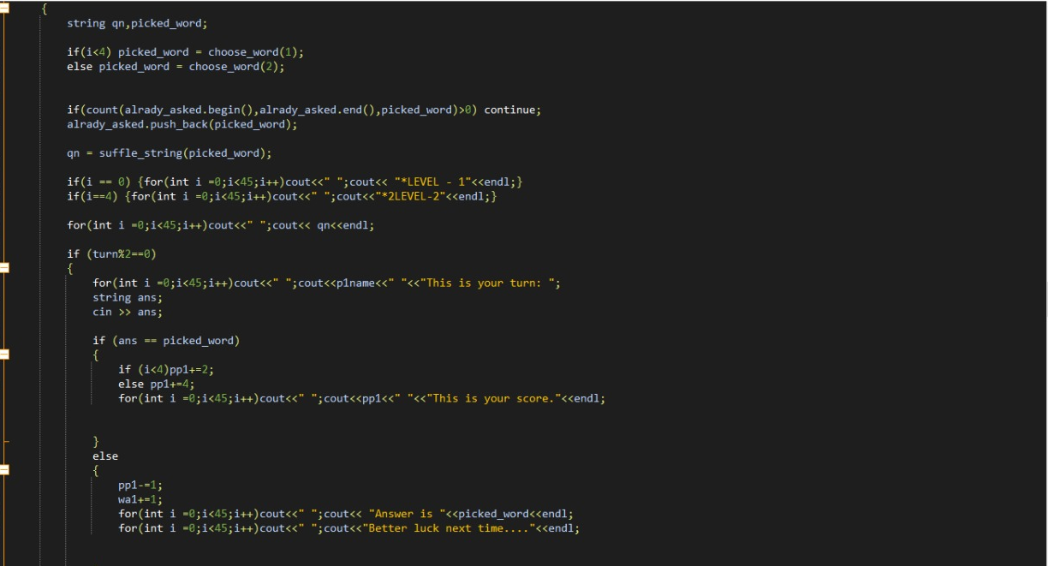
Department of ISE,RNSIT

Slide 15
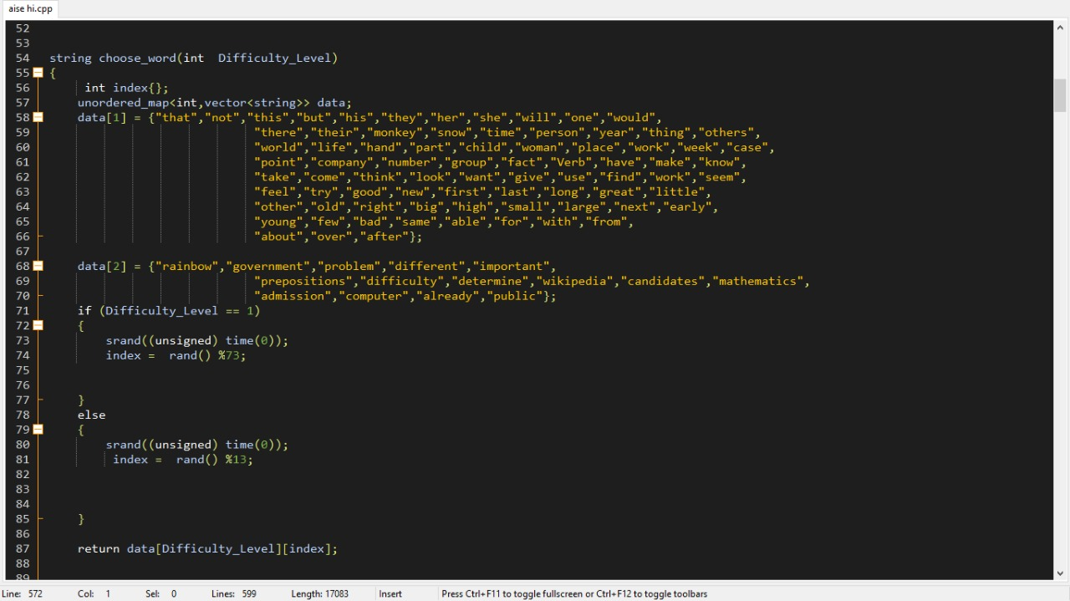
Department of ISE,RNSIT

Slide 16
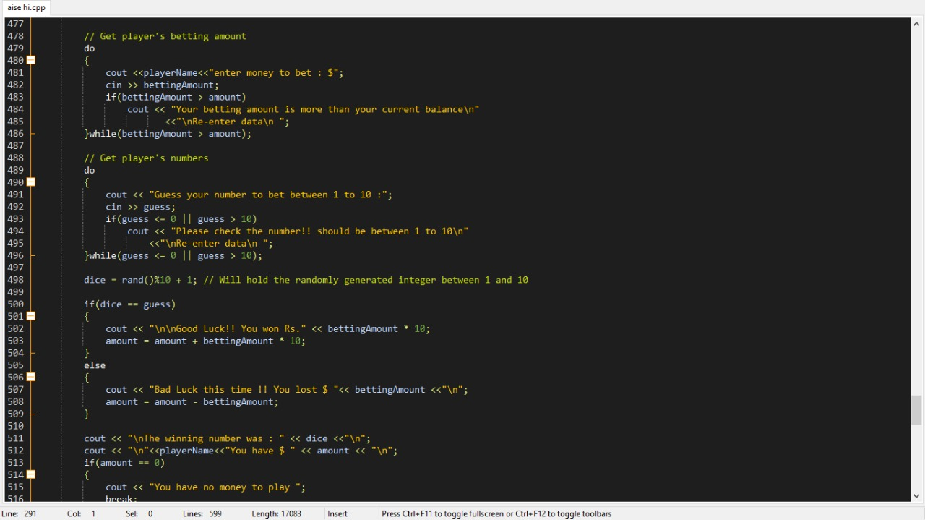
Department of ISE,RNSIT

Slide 17
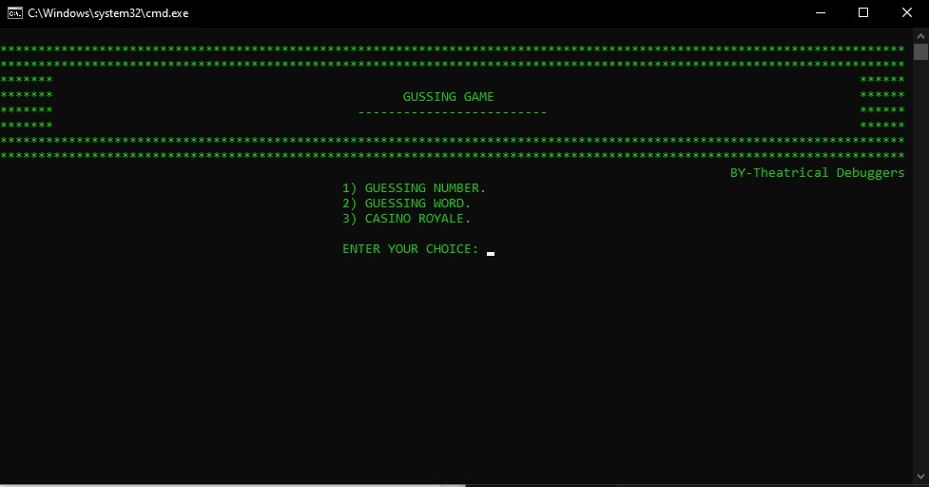
When the program is compiled and run option is clicked the first screen displays like this and three option is visible to the player/user.
Department of ISE,RNSIT

Slide 18
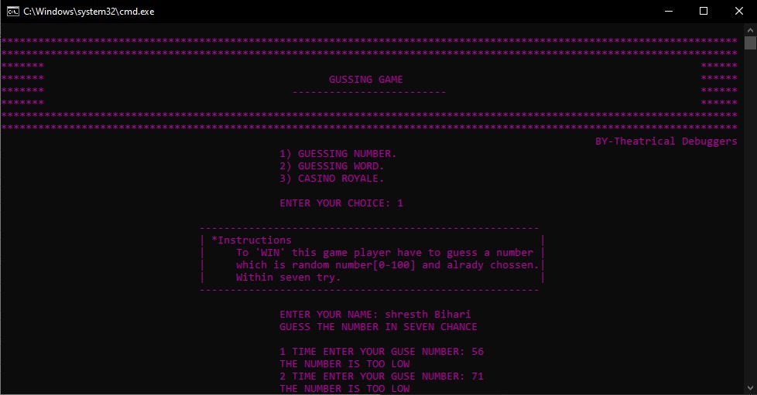
If the user/player clicks on the first option, he/she is directed to play guessing number which is shown in the above picture.
Department of ISE,RNSIT

Slide 19
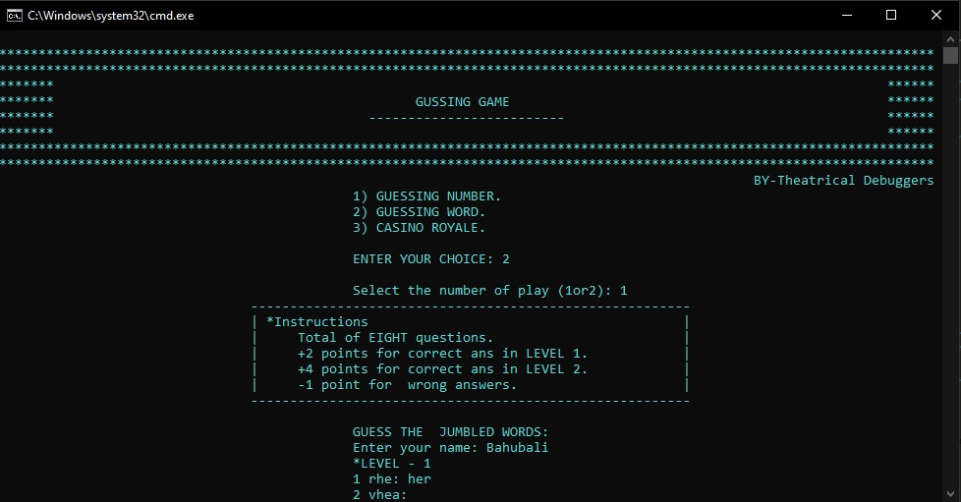
This screen is for guessing words for single player /user which clearly depicts the instructions to play it .
Department of ISE,RNSIT

Slide 20
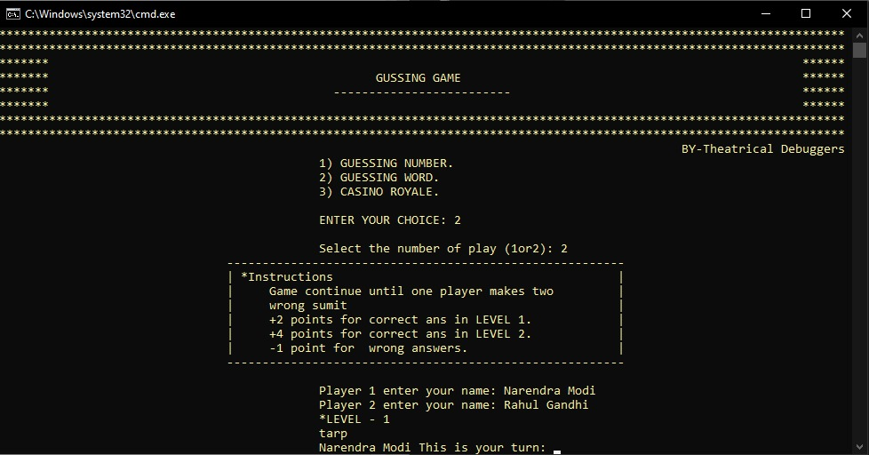
This screen shows the Guessing word game for double player with instructions on it .
Department of ISE,RNSIT

Slide 21
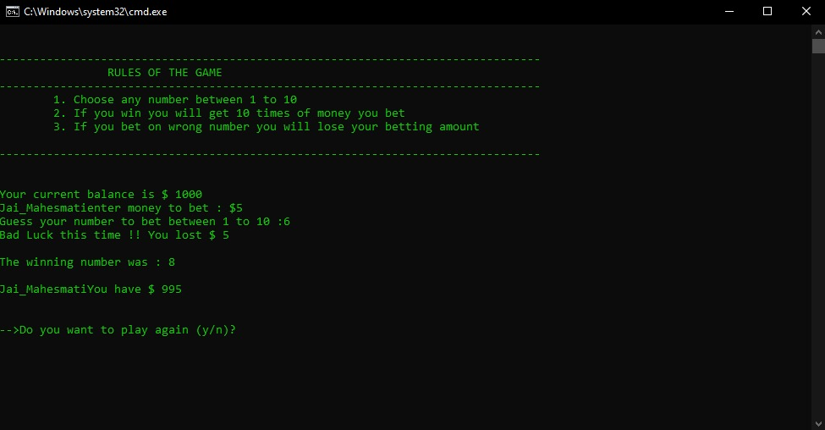
This is the Casino Royale game with instructions and gameplay of some player .
Department of ISE,RNSIT

Slide 22
In the case of “Guessing game” we will use web -scrapping to generate random words from internet . Also we can enhance our games to be in multiplayer mode that is making it to run for more than two players . Our future plans include to go into website mode till next semester and we are also working on the android version of the game. We also create a database for the game which will increase the features of the game like remembering the high scores.
Department of ISE,RNSIT

Slide 23

Department of ISE,RNSIT

